Slide 1


Department of BES-I
COURSE: Data Structures Using Python
COURSE CODE: 24SC1204
Topic: 2.13
Name of the topic:
Types of Queues -Double Ended Queue
Session –20

Slide 2



AIM OF THE SESSION
To familiarize students with the basic concept of Double Ended Queue
INSTRUCTIONAL OBJECTIVES
This Session is designed to:
Demonstrate the Double ended Queue (deque)
Describe the types of deque
List out the operations possible on the deque.
Describe the each operation
List out the advantages and applications of deque.
LEARNING OUTCOMES
At the end of this session, you should be able to:
Define Double Ended Queue (deque)
Describe two types of deque. And their operations
Summarize definition, types and operations of deque and its applications

Slide 3
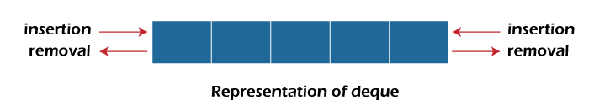
Double Ended Queue
INTRODUCTION
A double-ended queue is a linear data structure where the insertion and deletion operations are performed from both ends. It is also called as deque(Deck).
Though the insertion and deletion in a deque can be performed on both ends, it does not follow the FIFO rule. The representation of a deque is given as follows:

Slide 4
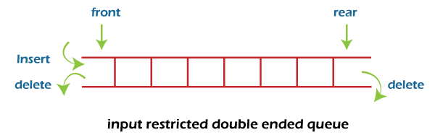
Types of Double Ended Queues
There are two types of deque:
  Input restricted queue
  Output restricted queue.
1. Input restricted Queue :
In input restricted queue, insertion operation can be performed ar only one end, while deletion can be performed from both ends.

Slide 5
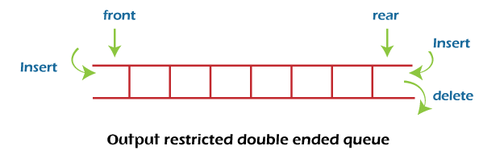
Types of Double Ended Queues Contd…
2. Output restricted Queue:
In output restricted queue, deletion operation can be performed at only one end, while insertion can be performed from both ends.

Slide 6
OPERATIONS ON DEQUE
In a double ended queue, we can perform the following operations...
  Insert at Front: Add an element to the front of the deque.
  Insert at Rear: Add an element to the rear of the deque.
  Delete from Front: Remove an element from the front of the deque.
  Delete from Rear: Remove an element from the rear of the deque.
  Peek Front: Retrieve the front element without removing it.
  Peek Rear: Retrieve the rear element without removing it.

Slide 7
OPERATIONS ON DEQUE (Cont..)
Insertion at the front end:
In this operation, the element is inserted from the front end of the queue. Before implementing the operation, first we have to check whether the queue is full or not. If the queue is not full, then the element can be inserted from the front end by using the following conditions:
  If the queue is empty, both rear and front are initialized with 0. Now, both will point to the first element.
  otherwise, check the position of the front, if the front is less than 1, then reinitialize it by front=n-1 i.e., the last index of the array.

Slide 8
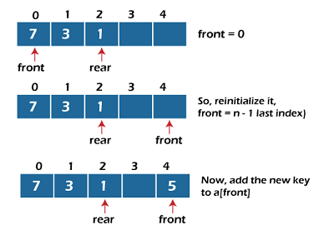
OPERATIONS ON DEQUE (Cont..)

Slide 9
OPERATIONS ON DEQUE (Cont..)
2. Insertion at the rear end:
In this operation, the element is inserted from the rear end of the queue. Before implementing the operation, first we have to check whether the queue is full or not. If the queue is not full, then the element can be inserted from the rear end by using the below conditions:
If the queue is empty, both rear and front are initialized with 0. Now, both will point to the first element.
Otherwise, increment the rear by 1. If the rear is at last index ( or size -1), then instead of increasing it by 1, we have to make it equal to 0.

Slide 10
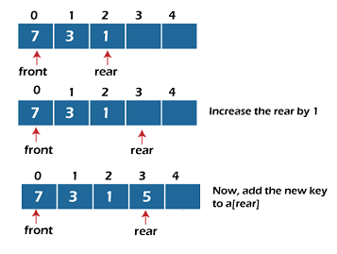
OPERATIONS ON DEQUE (Cont..)

Slide 11
OPERATIONS ON DEQUE (Cont..)
3. Deletion at the front end:
In this operation, the element is deleted from the front end of the queue. Before implementing the operation, we first check whether the queue is empty or not.
If the queue is empty i.e., front = -1, it is the underflow condition, and we cannot perform the deletion. If the queue is not full, then the element an be inserted from the front end by using the below conditions:
If the deque has only one element, set rear = -1 and front = -1
else, if front is at end (that means front = size – 1) set front = 0’
else, increment the front by 1. (i.e., front = front + 1)

Slide 12
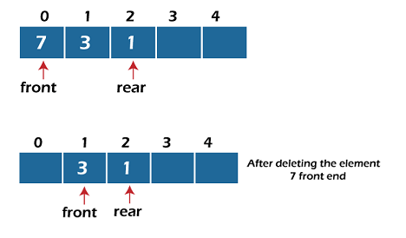
OPERATIONS ON DEQUE (Cont..)

Slide 13
OPERATIONS ON DEQUE (Cont..)
4. Deletion at the rear end:
In this operation, the element is deleted from the rear end of the queue. Before implementing the queue operation, we first check the queue is empty or not.
If the queue is empty, i.e., front = -1, it is the underflow condition, and we can’t perform the deletion.
If the deque has only one element, set rear = -1 and front = -1.
If rear = 0 (rear is at front), then set rear = n-1.
else, decrement the rear by 1 (or rear = rear – 1)

Slide 14
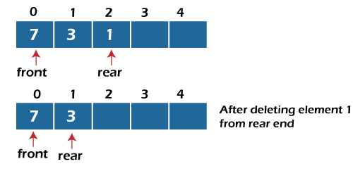
OPERATIONS ON DEQUE (Cont..)

Slide 15
OPERATIONS ON DEQUE (Cont..)
The basic operations of a deque:
append(x) – Adds x to the right end of the deque.
appendleft(x) – Adds x to the left end of the deque.
pop() – Removes and returns the rightmost element.
popleft() – Removes and returns the leftmost element.
peek (front/rear) – View the front or rear element without removing it.
clear() – Removes all elements from the deque.

Slide 16
Min-Priority Queue (Dequeue Operation)
In a min-priority queue, the item with the smallest priority value is dequeued first.
Python’s heapq implements a min-heap by default, which makes it a natural fit for this type of queue.
Dequeue Algorithm in Min-Priority Queue:
Check if the queue is empty: If the queue is empty, the operation should raise an error or return None.
Remove the highest priority element: The highest priority element is always at the root (index 0) of the heap.
Return the removed element: Return the element with the smallest priority value.

Slide 17
Python Code for Min-Priority Queue (Dequeue Operation)
import heapq
class PriorityQueue:
def __init__(self):
self._queue = []
self._index = 0
def enqueue(self, item, priority):
# Insert element as a tuple (priority, index, item)
heapq.heappush(self._queue, (priority, self._index, item))
self._index += 1
def dequeue(self):
if self.is_empty():
raise IndexError("dequeue from an empty priority queue")
return heapq.heappop(self._queue)[-1]
def peek(self):
if self.is_empty():
raise IndexError("peek from an empty priority queue")
return self._queue[0][-1]
def is_empty(self):
return len(self._queue) == 0
# Example Usage:
pq = PriorityQueue()
pq.enqueue("task1", priority=3)
pq.enqueue("task2", priority=1)
pq.enqueue("task3", priority=2)
# Dequeue operations
print(pq.dequeue())
print(pq.dequeue())
print(pq.peek())
print(pq.dequeue())
OUTPUT :
task2
task3
task1
task1

Slide 18
Input Restricted Queue (Inserting at the Beginning)
def delete_from_front(self):
"""Delete an item from the front of the queue."""
if self.queue:
return self.queue.popleft()
else:
print("Queue is empty! Cannot delete from the front.")
return None
def delete_from_rear(self):
"""Delete an item from the rear of the queue."""
if self.queue:
return self.queue.pop()
else:
print("Queue is empty! Cannot delete from the rear.")
return None
def display(self):
"""Display the current state of the queue."""
print("Queue:", list(self.queue))
from collections import deque
class InputRestrictedQueue:
def __init__(self, size):
self.queue = deque(maxlen=size) # Initialize a deque with a max size
self.size = size
def insert_at_end(self, item):
"""Insert an item at the end (rear) of the queue."""
if len(self.queue) < self.size:
self.queue.append(item)
else:
print("Queue is full! Cannot insert at the rear.")
def insert_at_beginning(self, item):
"""Insert an item at the front (beginning) of the queue."""
if len(self.queue) < self.size:
self.queue.appendleft(item) # Insert at the front
else:
print("Queue is full! Cannot insert at the beginning.")

Slide 19
Input Restricted Queue (Inserting at the Beginning)
# Deleting from the rear
print("Deleted from rear:", queue.delete_from_rear()) # Output: Deleted from rear: 30
queue.display() # Output: Queue: [5, 10, 20]
OUTPUT :
Queue: [10, 20, 30]
Queue: [0, 5, 10, 20, 30]
Deleted from front: 0
Queue: [5, 10, 20, 30]
Deleted from rear: 30
Queue: [5, 10, 20]
queue = InputRestrictedQueue(size=5)
# Inserting at the rear
queue.insert_at_end(10)
queue.insert_at_end(20)
queue.insert_at_end(30)
queue.display() # Output: Queue: [10, 20, 30]
# Inserting at the front (beginning)
queue.insert_at_beginning(5)
queue.insert_at_beginning(0)
queue.display() # Output: Queue: [0, 5, 10, 20, 30]
# Deleting from the front
print("Deleted from front:", queue.delete_from_front()) # Output: Deleted from front: 0
queue.display() # Output: Queue: [5, 10, 20, 30]

Slide 20
APPLICATIONS OF DEQUEUE
Queue Implementation: For tasks like scheduling and processing in FIFO order.
Palindrome Checker: Efficient checking of palindromes by comparing characters from both ends.
Sliding Window Algorithms: For problems like finding maximum/minimum in a sliding window.
Circular Buffer: For implementing buffers that use a fixed amount of memory and wrap around.
Undo/Redo Operations: Storing actions for undo/redo functionality.
Breadth-First Search (BFS): Efficient traversal of graphs in level order.
LRU Cache: Efficient caching using the least recently used eviction policy.

Slide 21
SUMMARY
Double ended Queue is a linear data structure, where the insertion and deletion operations are performed from both ends. It is also called as deque.
In deque, there are two types...
i) Input restricted queue
ii) output restricted queue
In input restricted queue the following operations are performed:
i) Inserting At Beginning
ii) Inserting At End
In output restricted queue, the following operations are performed:
i) Deleting from Beginning
ii) Deleting from End

Slide 22
SELF-ASSESSMENT QUESTIONS
Which of the following application makes use of a deque?
a) Checks palindrome
b) Insert an element
c) Delete an element
d) All the above
2. Which of the following is true to check deque is full or not?
a) front = rear + 1
b) Front = rear
c) front=0
d) rear=-1

Slide 23
TERMINAL QUESTIONS
1. Describe About double ended queue?
2. List out different types of deque?
3. List out different operations can perform on deque?
4. Analyze the time complexity of the deque for the operations such as insertion, deletion.

Slide 24
REFERENCES FOR FURTHER LEARNING OF THE SESSION
Textbooks:
Mark Allen Weiss, Data Structures and Algorithm Analysis in C, 2010, Second Edition, Pearson Education.
Allen B. Downey, ”Think Python: How to Think Like a Computer Scientist’’, 2nd edition, Updated for Python 3, Shroff/O’Reilly Publishers, 2016 (http://greenteapress.com/wp/thinkpython/)
Data Structures and algorithms using python, 2011,Rance D, Necaise, himilton printing
ReferenceBooks:
Data Structures and Algorithm Analysis in PYTHON, 2010, Mark Allen Weiss, Second Edition, Pearson Education.
Data Structures and Algorithms, A.V.Aho, J.E.Hopcroft, and J.D.Ullman, Pearson Education, First Edition Reprint2003.
Advanced Guide to Python 3 Programming, John Hunt, 4th Edition, Springer Nature Switzerland AG 2019.
Python Basics: A Practice Introduction to Python 3, David Amos, Dan Bader, Joanna Jablonski, Fletcher Heisler, 4th edition, Real Python.
WebLinks:
https://docs.python.org/3/tutorial/datastructures.html
https://www.w3schools.com/dsa/dsa_intro.php
https://www.geeksforgeeks.org/python-data-structures/

Slide 25
THANK YOU
Team – Data Sructures

